Slide 1

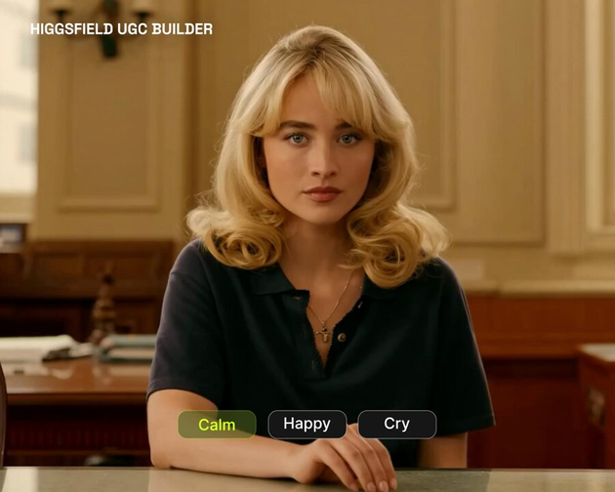
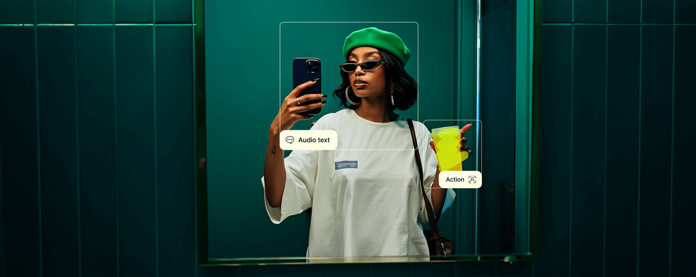

HIGGSFIELD
UGC Studio’s New AI Features

Slide 2
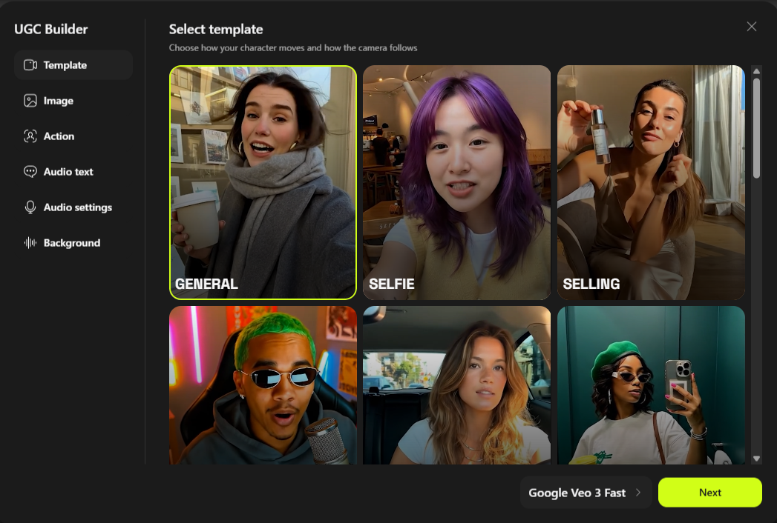
UGC BUILDER
KEY CAPABILITIES
  Camera Motion: Choose from cinematic presets like crash zoom, dolly, jib, whip pan, more.
  Avatar or Image Input: upload your photo or pick a built‑in avatar.
  Action Prompts: define character movement and behavior.
  Emotion & Voice Controls: set mood, tone, accent, language.
  Background Sound: add ambiance, music, or environmental audio.

Slide 3
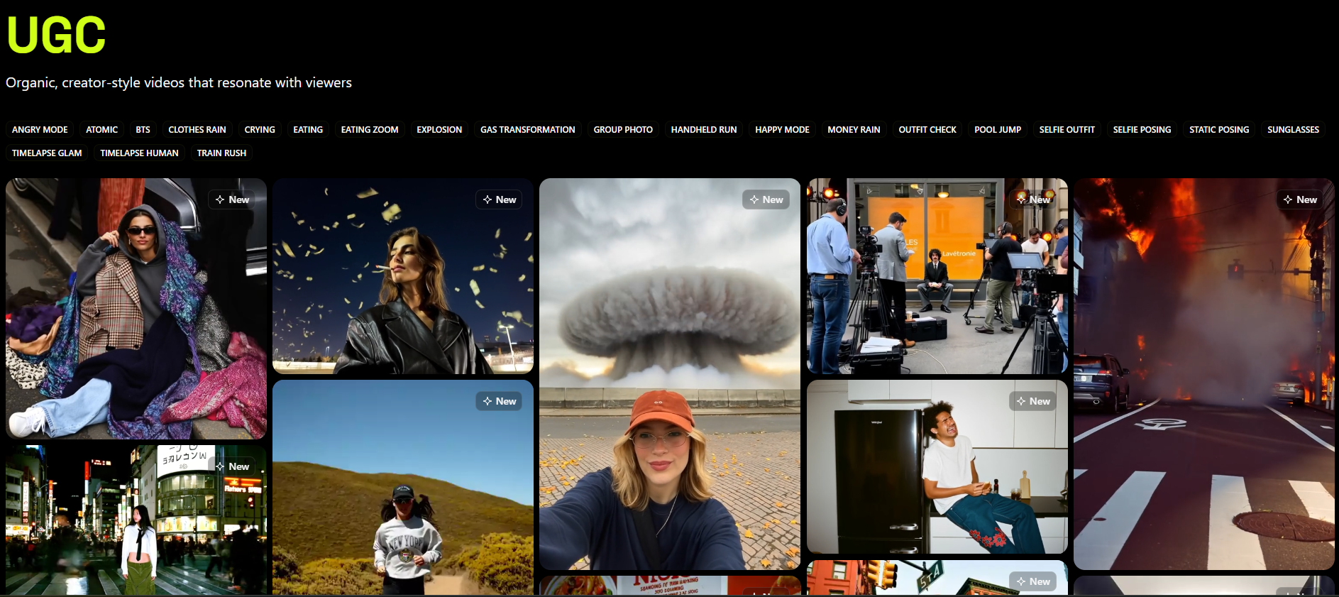
HOW TO CREATE A UGC VIDEO
KEY MILESTONES IN CLOUD DEVELOPMENT
•Step 1: Go to Higgsfield UGC Builder set Templated for a camera action.
•Step 2: Choose or upload an input image.
•Step 3: Add Action for the character using a prompts, Audio, and Audio settings (voice type, Emotion,language,accent tones).
•Step 4: Customize background sound
•Step 5: Generate video , one video credit take , 80 to 150 based on the fast or High.

Slide 4
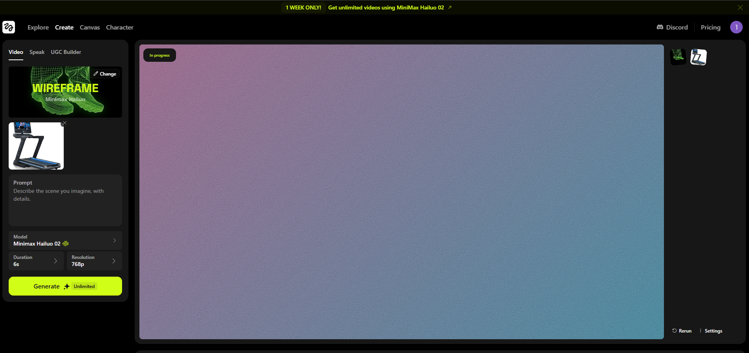
RENDING TIME
One video typically takes 5 to 10 minutes to render after setup.

Slide 5
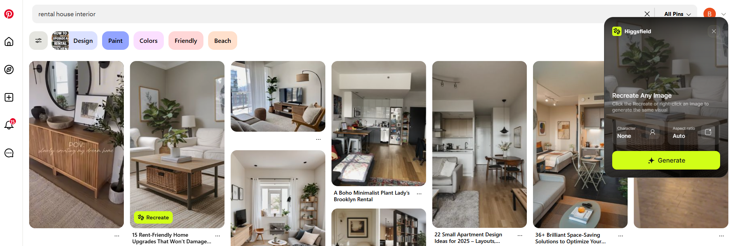
HIGGSFIELD REFERENCE CHROME EXTENSION
This Extension it’s use full for the taken the reference for the background
This new extension only work on the Pinterest only.

Slide 6

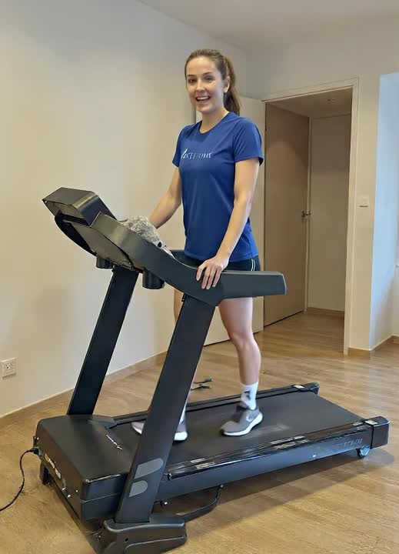
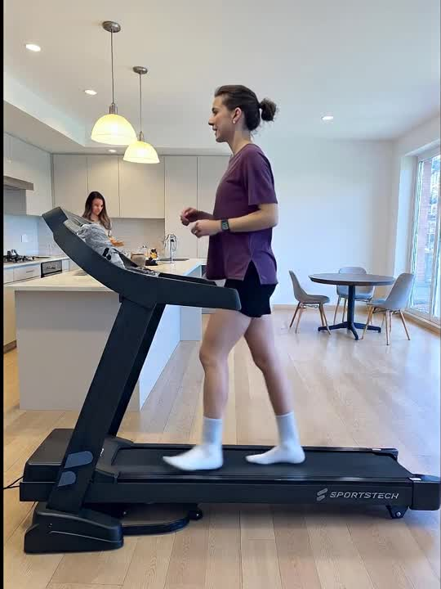
OUTPUT

Slide 7
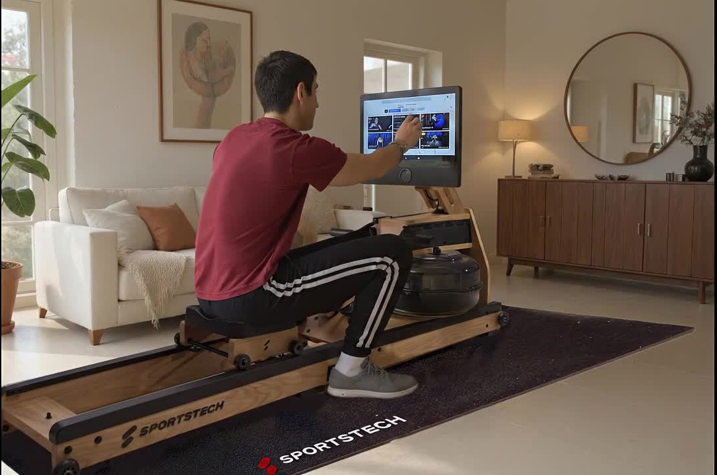
OUTPUT

Slide 8
CONCLUSION
While Higgsfield’s UGC Builder has some really cool tech and is super easy to use, the videos it creates still look pretty obviously AI-generated. That makes them less ideal for real UGC marketing, where content needs to feel authentic and natural.
That said, it actually performs really well for cinematic ads and lifestyle-focused videos, especially for things like clothing promotions or aesthetic product showcases. If you're selling fashion or creating visual-style content, it delivers a polished and eye-catching result.
But for our UGC concept, which relies on authentic, human-like storytelling and a raw influencer vibe, the AI output just doesn’t quite fit. It feels a bit too scripted or artificial for the kind of emotional connection we’re aiming for.
Still, Higgsfield is headed in the right direction. If they improve realism and natural motion, this could turn into a strong tool down the line.

Slide 9
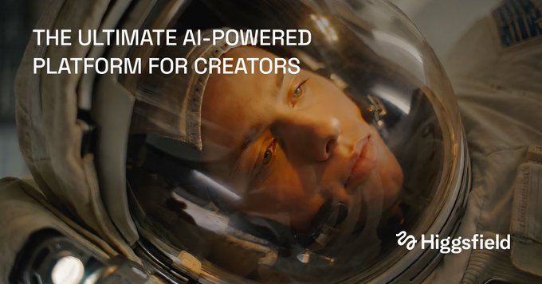
THANK YOU

